Slide 1
How can language models dynamically allocate resources for parallel thinking?
Wufei Ma and Jalil Rezek
Nov 11, 2025
Notes:
Hi — Welcome to the self-supervised learning class!

Slide 2
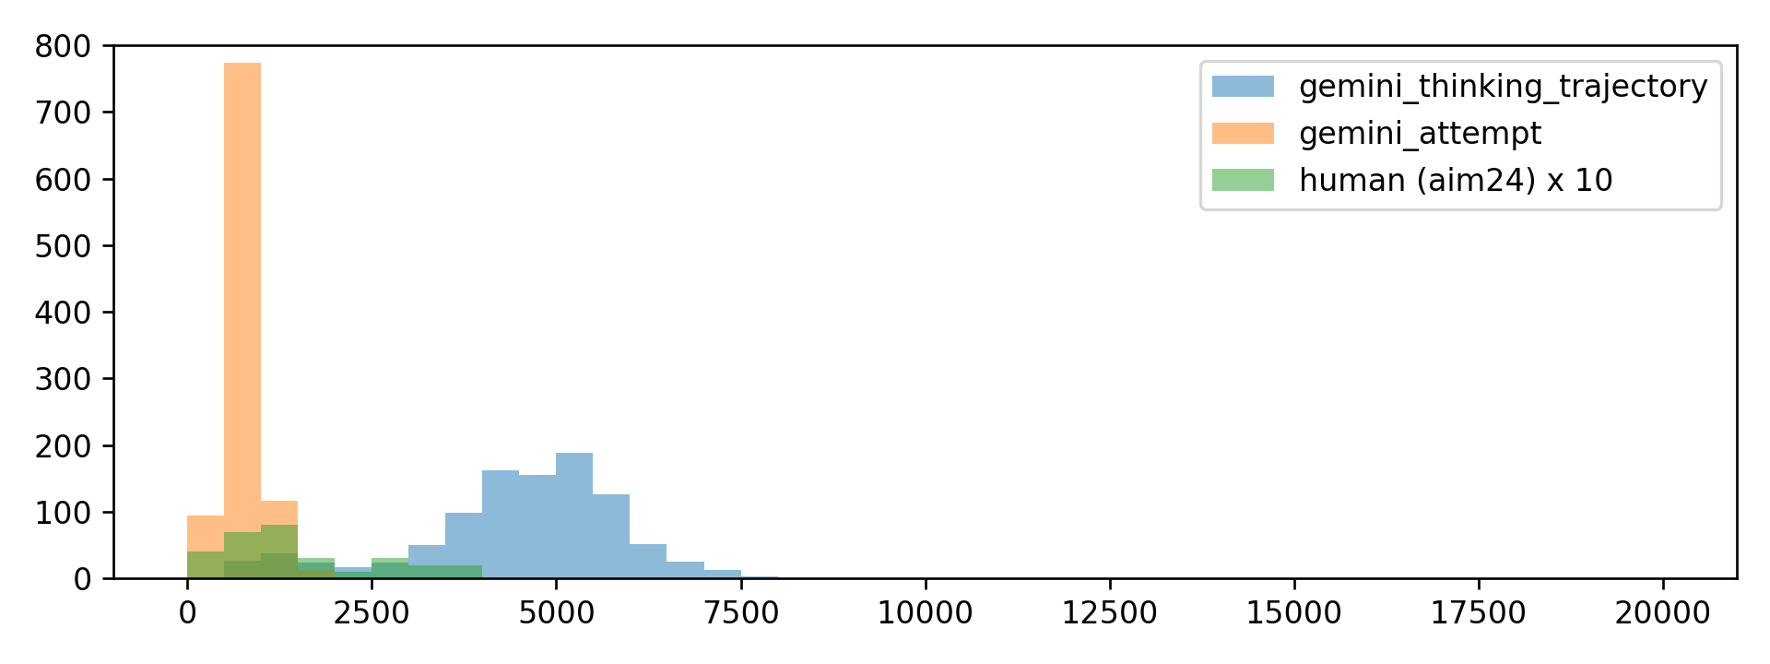
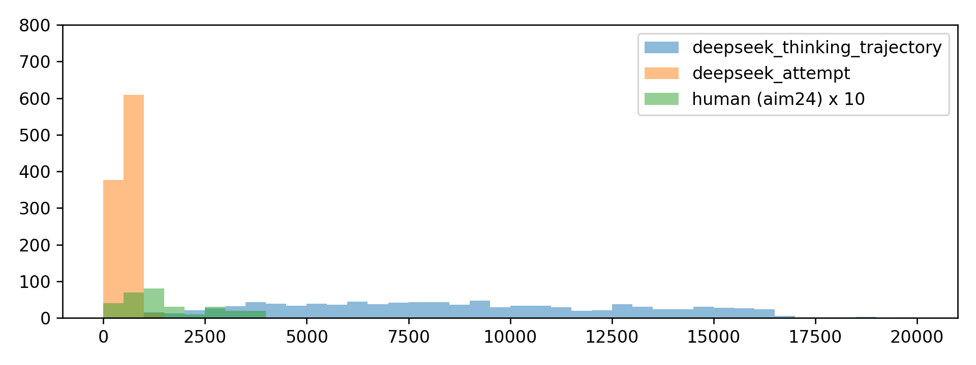
Inference-Time Computation
Single model:
Data: s1k-1.1 (math reasoning)
Top: Gemini; bottom: deepseek.
Orange: attempt; blue: thinking trajectory; green: human baseline.
[1] Muennighoff et al. s1: Simple test-time scaling.

Slide 3


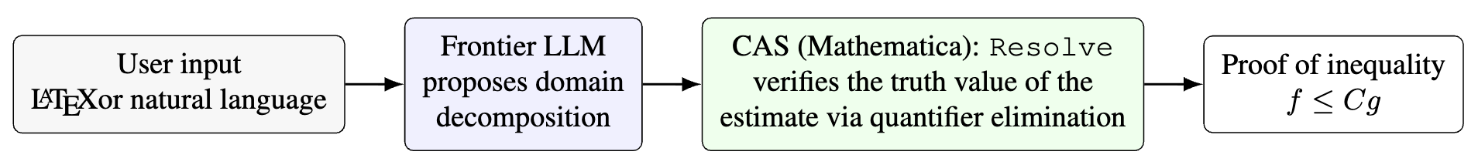
Inference-Time Computation
Tool use (math reasoning & proof)
Python REPL
CAS (Mathematica)

Slide 4
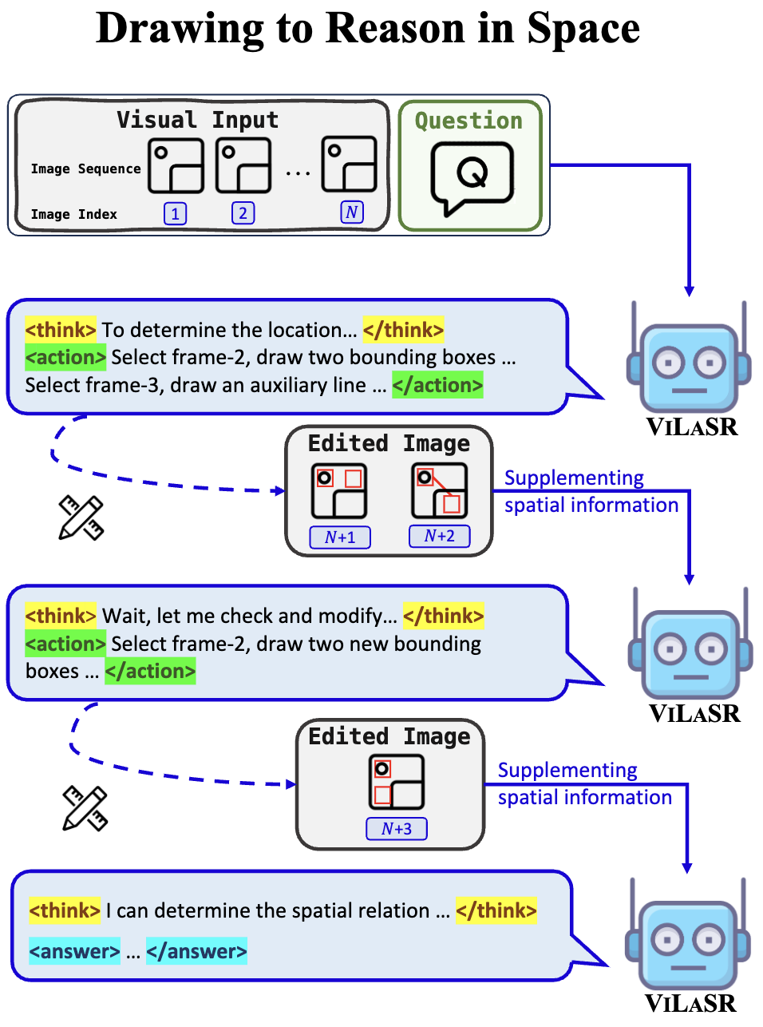
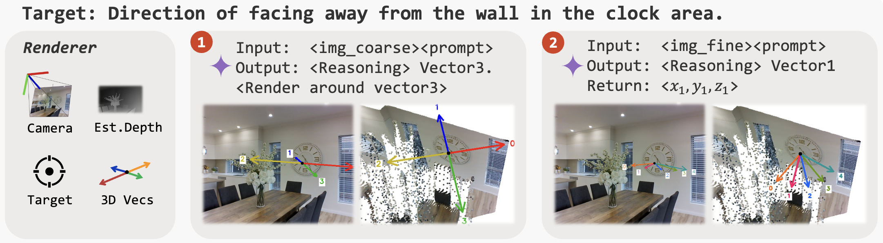
Inference-Time Computation
Tool use (multi-modal)

Slide 5
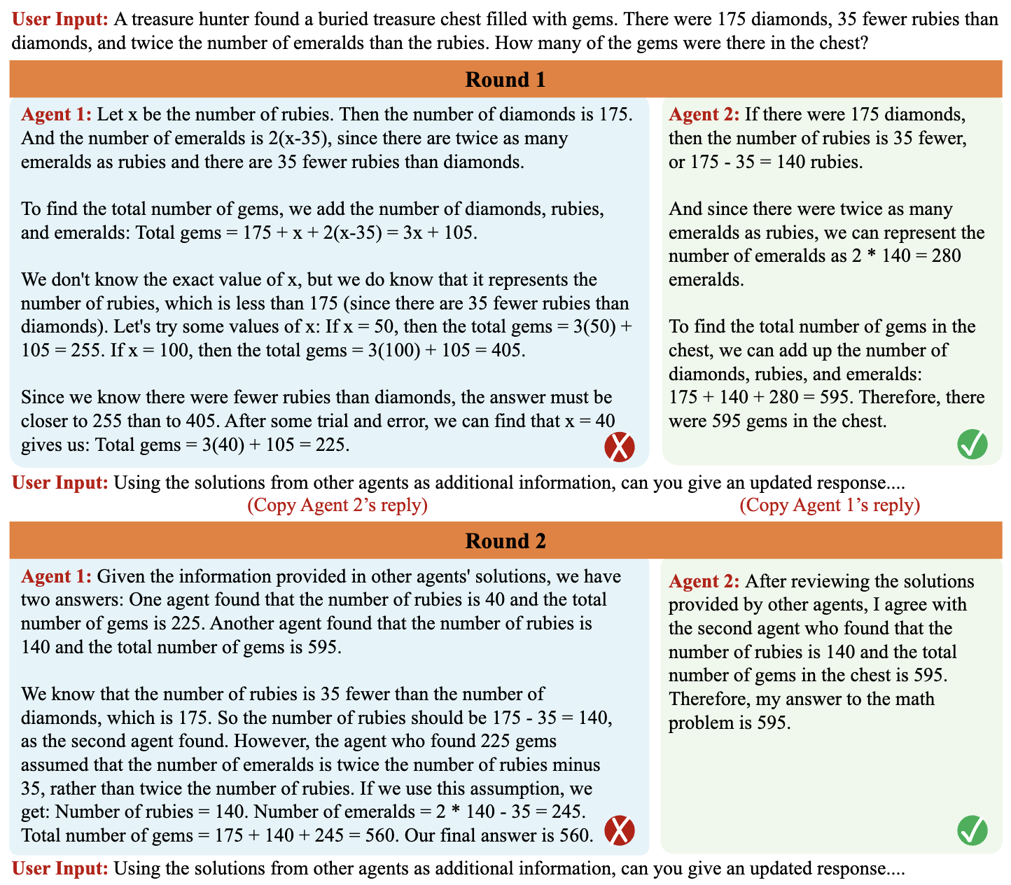
Inference-Time Computation
Multi-agent debate

Slide 6
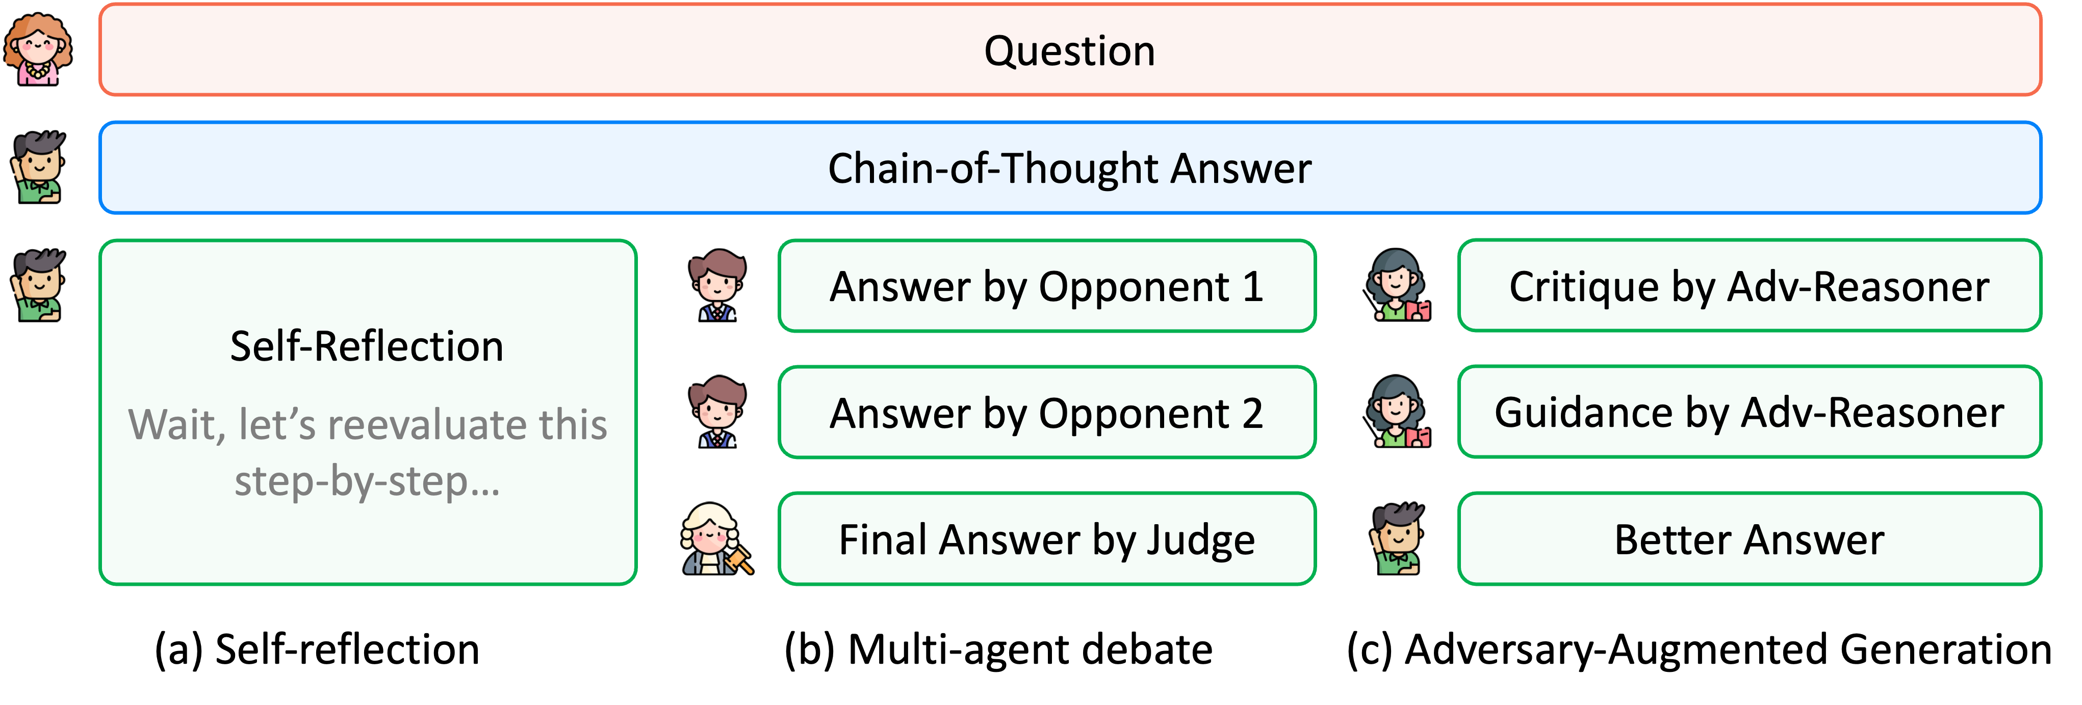
Inference-Time Computation
Guidance from judger

Slide 7
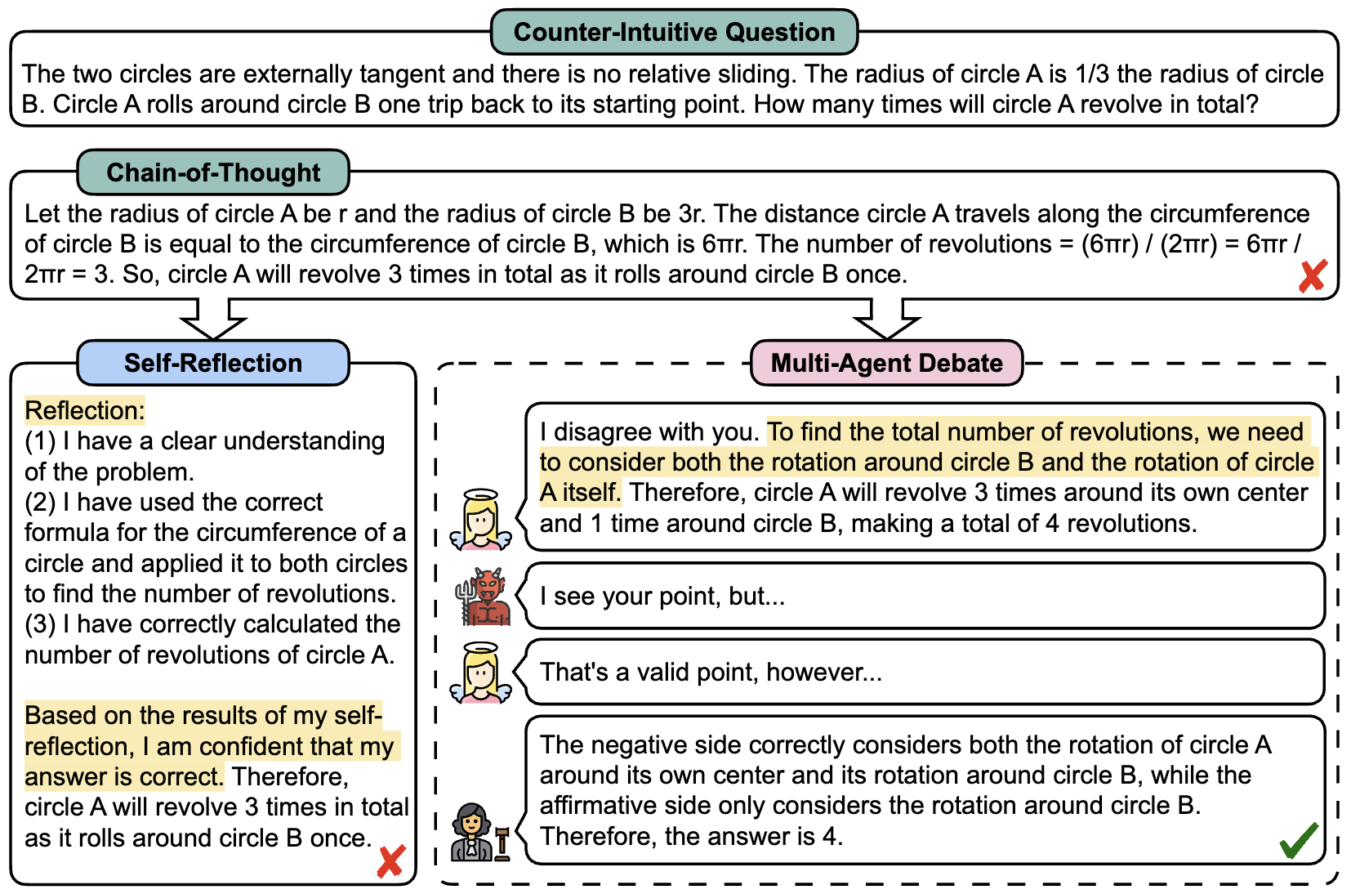
Inference-Time Computation
Divergent thinking

Slide 8
Challenge
Very long reasoning at test-time.
Self-reflection, tool-use, multi-agent, etc.
One solution: parallelism

Slide 9
Parallelism
Data Parallelism
Model (Tensor) Parallelism
Saves memory
Running larger models
Bigger batch size
Improving latency or throughput
Pipeline Parallelism
Sequence Parallelism
MoE Parallelism
Task (Thinking) Parallelism

Slide 10
Challenge
Problem
Sequential

Slide 11
Challenge
Problem
Well-defined sub-tasks
Synthetic datasets where each sample consists of 5 math questions
Real-world problems where we consider different conditions?
Nice parallelism

Slide 12
Challenge
Problem
Multi-agent solving similar problems
Communication (dependency) between agents
Multi-agent “debate”
Not fully parallelizable

Slide 13
Challenge
Problem
Multi-agent solving similar problems
Communication (dependency) between agents
Multi-agent “debate”
Not fully parallelizable
Straggler effect

Slide 14
Hogwild! Inference: Parallel LLM Generation via Concurrent Attention
Rodionov et al.

Slide 15
Challenge
Problem
We don’t want threads waiting long for each other:
Better parallelism and efficiency
Effective reasoning in one agent can quickly benefit other agents too

Slide 16
KV Cache Structure
When is KV cache shared?
When a worker generates “\n\n”, copy and share the KV cache, resume the decoding.

Slide 17
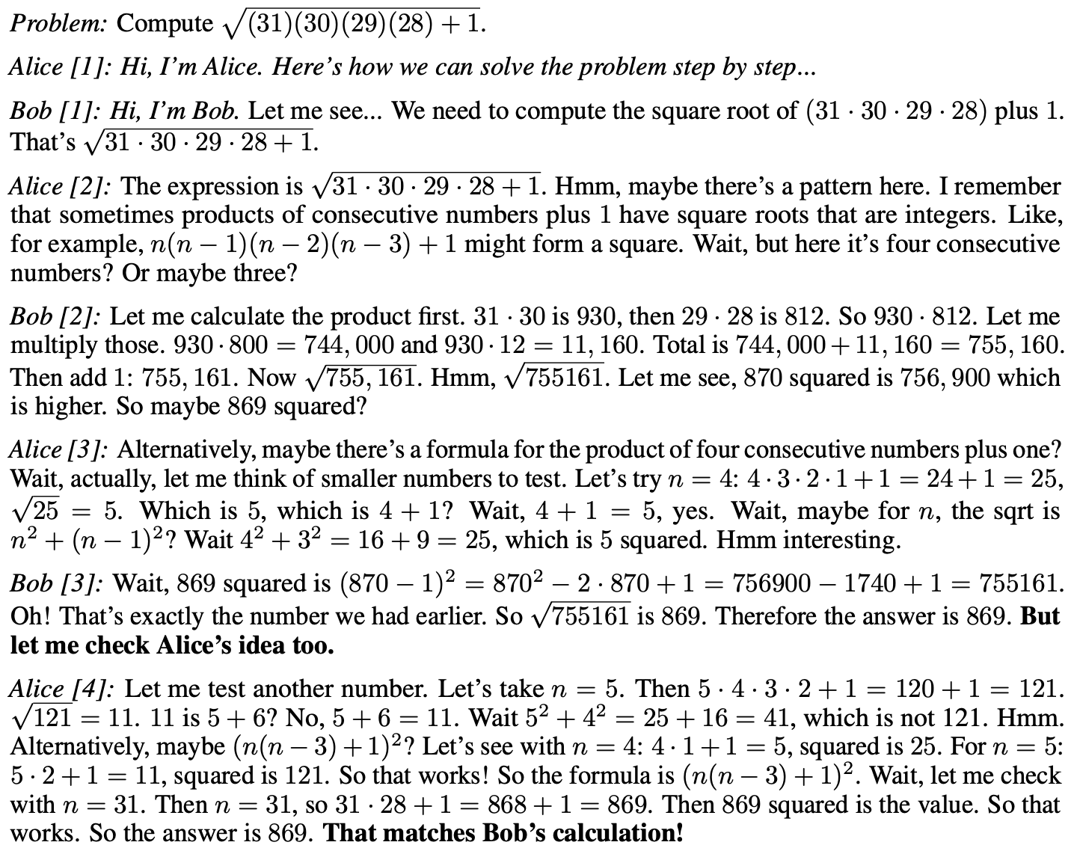
KV Cache Structure
Problem
…
…
…

Slide 18
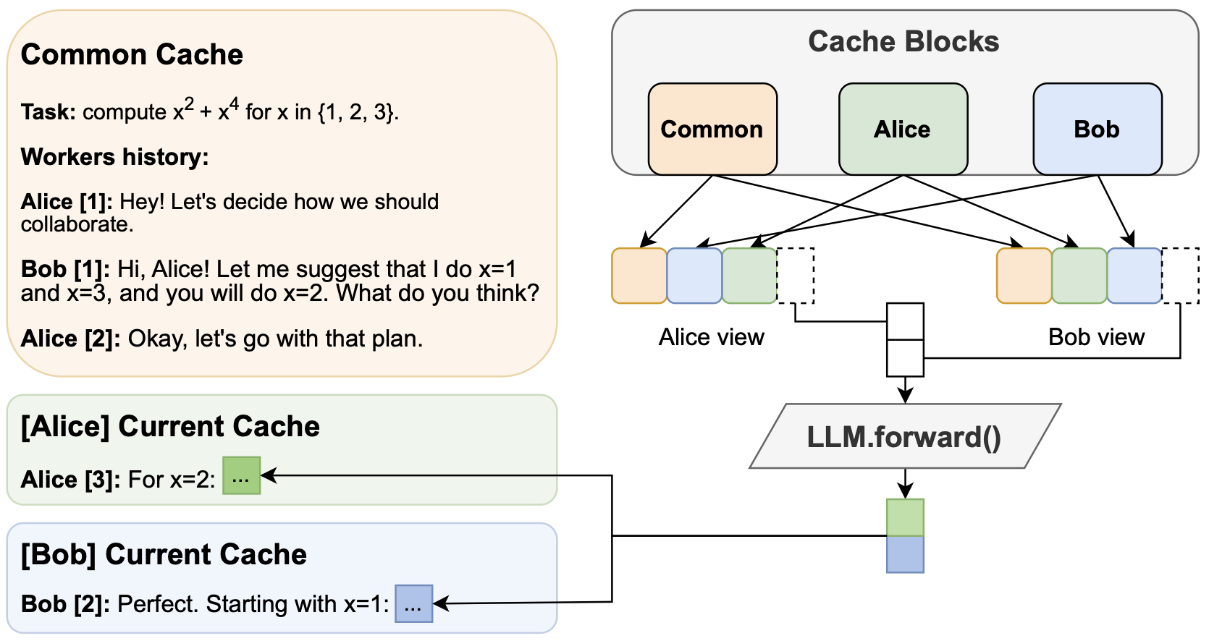
Hogwild!: Shared KV Cache

Slide 19
Token Ordering
Shuffle ordering of cache blocks from other agents
We want randomness in ensemble models.
Assume base LLM uses RoPE.
How to deal with new token positions?
Naïve way: KV cache before RoPE; overhead scales cubically.

Slide 20
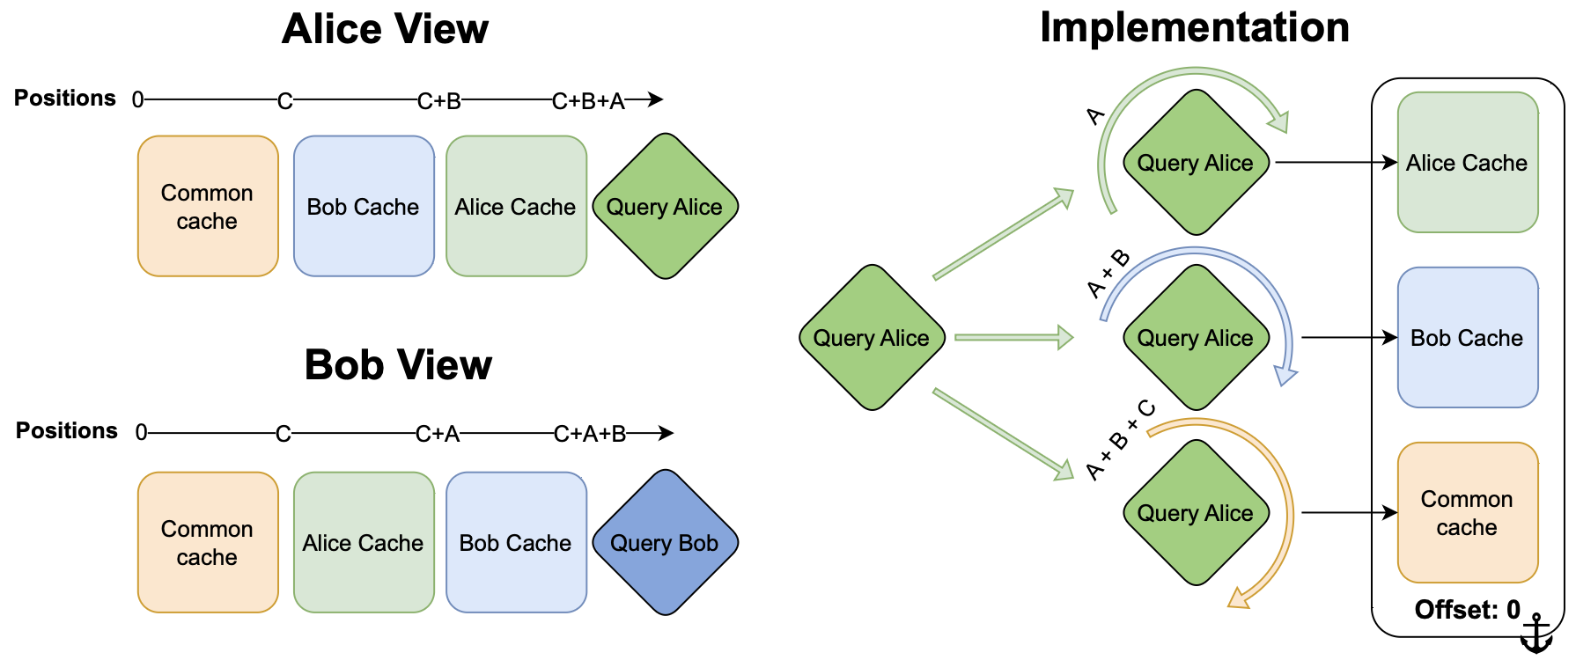
Token Ordering
Assumption: a lot of “key” tokens from other (n-1) agents.
Better way: rotate query to accommodate new positions.

Slide 21
Trick: Prompting
System prompt: describe the rules of “shared cache”.
Collaboration prompt: “Wait, am I doing redundant work? (yes/no):”.

Slide 22
Experiments: Baseline Methods
Sekeleton-of-thought (SoT)
A planner LLM generates outline and sub-tasks
Parallel threads solve sub-tasks
Aggregate results for final prediction
Self-consistency:
LLM instances solve problem independently
View concatenated solutions before final prediction

Slide 23
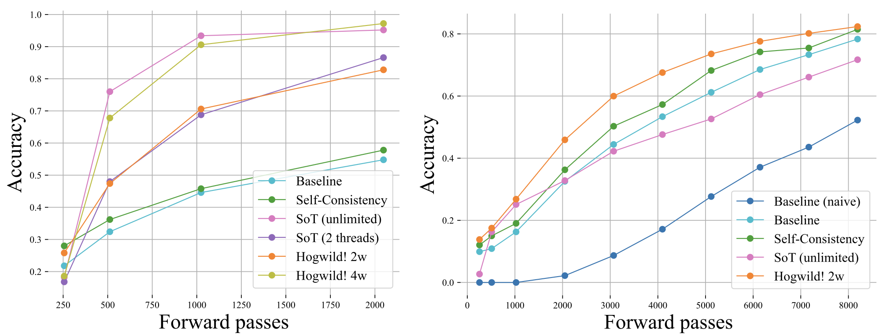
Experiments: Results
SoT performs well when there are well-defined sub-tasks.
Synthetic tasks with 5 GSM8k questions
LIMO

Slide 24
Experiments: Results
Hogwild! and self-consistency outperforms when planning ahead is hard.
Synthetic tasks with 5 GSM8k questions
LIMO

Slide 25
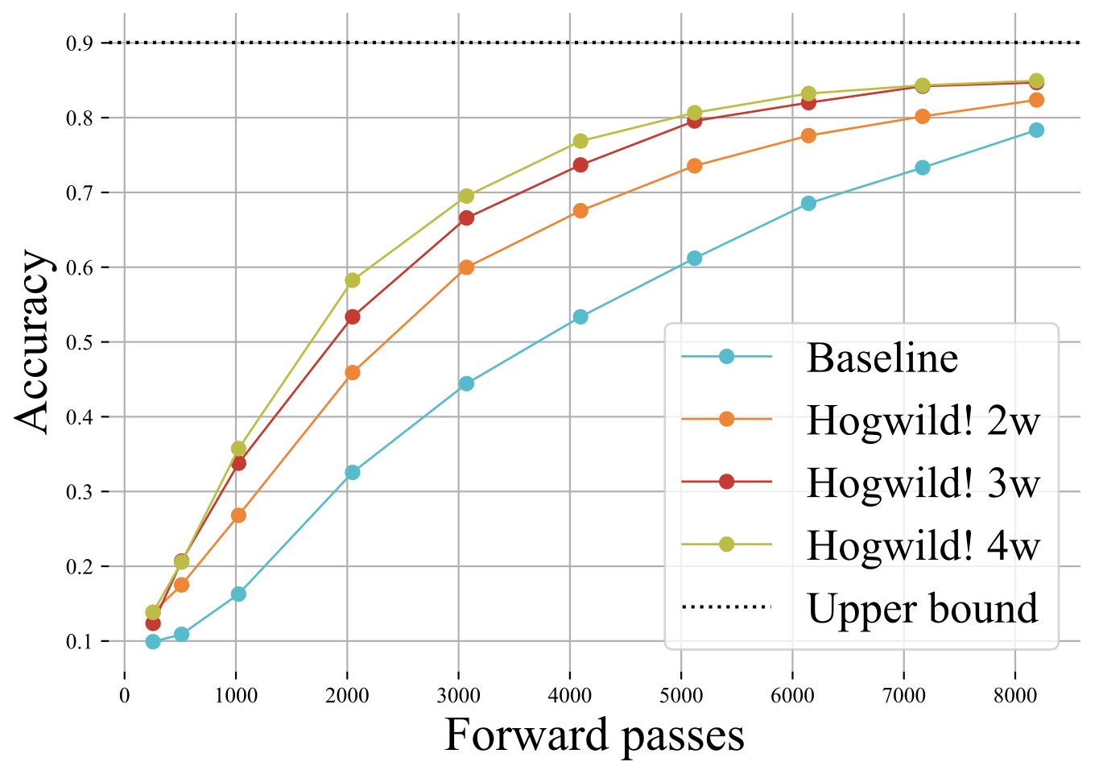
How many workers?
Diminishing returns

Slide 26
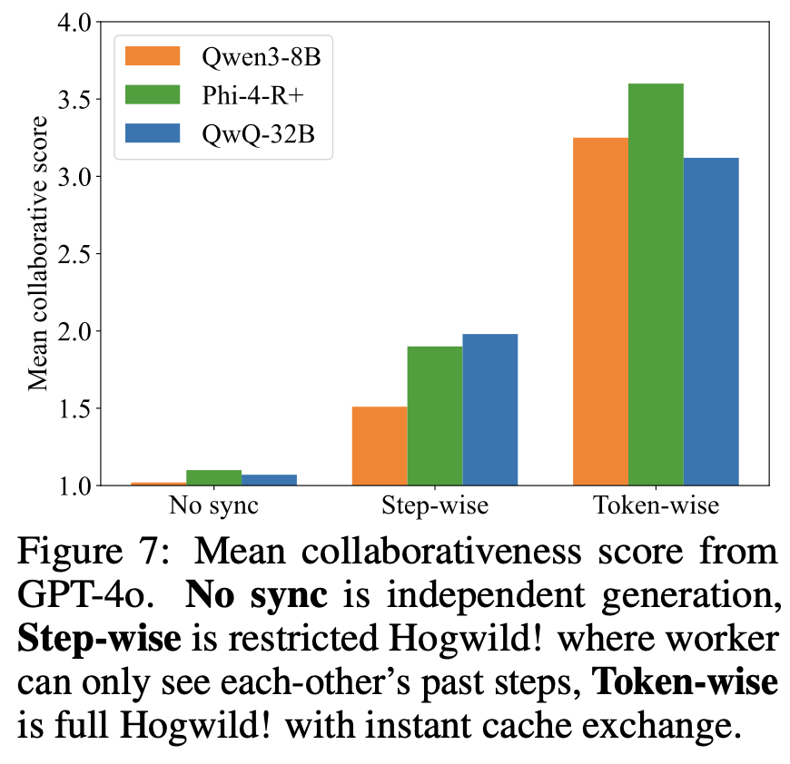
“Collaborativeness”
LLM-as-a-judge: GPT-4o score collaboration
1 as “no collaboration” and 6 as “optimal collaboration”

Slide 27
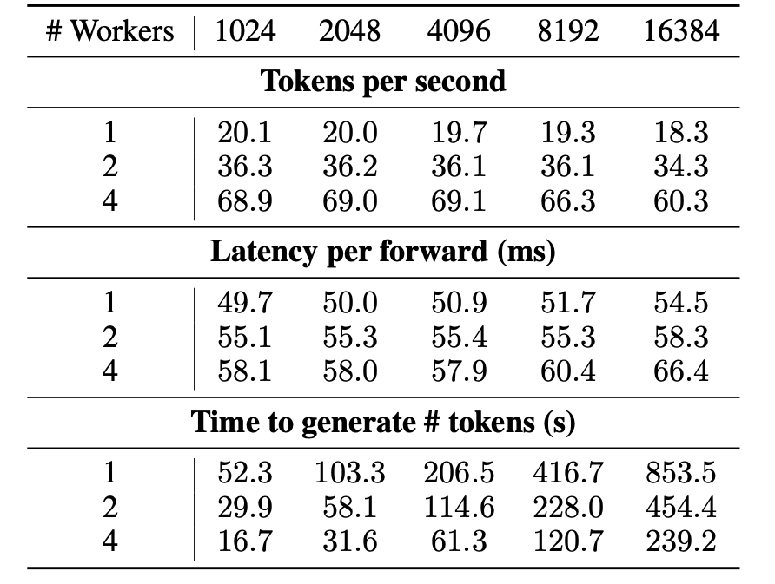
Efficiency
Small latency overhead
Near-linear scaling
(However, a lot of duplicate reasoning & diminishing returns of performance.)

Slide 28
How Hogwild! improves performance?
Model self-ensemble
More timely interaction (compared to standard multi-agent systems)
Divergent thinking

Slide 29
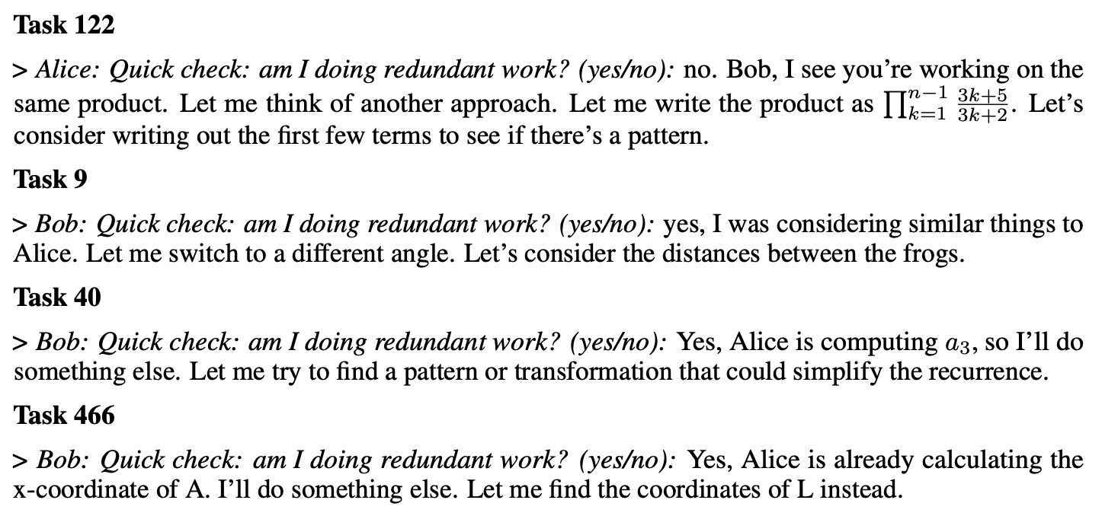
How Hogwild! Inference works?
Example: divergent thinking

Slide 30
Takeaways
Task (thinking) parallelism: some of the thinking process can happen in parallel.
Consider the deep research mode of ChatGPT – we are exploring a lot of possible directions, each taking very long thinking.
What kind of problems are suitable for parallel thinking?
Well-defined sub-tasks
If we want self-ensemble – multi-agent debate.
When do threads “sync”?
Waiting long – after finishing sub-tasks.
More frequently – quick pruning and converging thoughts.
Hogwild!

Slide 31
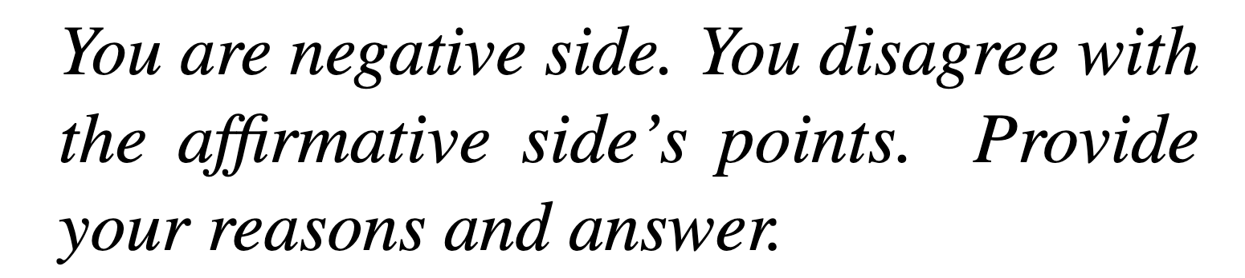
Discussions
Can Hogwild! Inference enable more effective collaboration beyond “prompted” divergent thinking?
Theoretically yes but unclear from current experiments.
Future of task (thinking) parallelism.
Trade-off between performance gains and overhead from multi-agent debate.
Nicely splitting big problems into sub-tasks is nice. What problems are suitable for sub-tasking and can LLMs achieve this with simple prompting?

Slide 32
Learning Adaptive Parallel Reasoning with Language Models
Pan, Lu, et al.

Slide 33
Motivation
Serialized chain-of-thought methods
Increased latency
Strain context window limits
Parallel methods
Lack coordination between inference paths
Redundant computation, limiting improvement and scalability
Structured inference-time search methods
Hand-designed search structures
Limited flexibility and scalability

Slide 34
Adaptive Parallel Reasoning (APR)
Models learn when and how to parallelize their inference operations.
No need for fixed search structures
Generalizes existing approaches
Model learns to combine breadth (parallelism) with depth (of individual branches)

Slide 35

Key Innovation 1: Parent-Child Threading
Parent-child threading
Parent thread spawns child threads via spawn() to explore subproblems
Each child runs independently in parallel and returns concise results via join()
RL trains model to decide:
When to branch or join
Prompts to feed to children
How many children to spawn
How to integrate results
Subproblem 1
Spawn()
Join()
Child 1
Parent
Parent
Child 2
Spawn()
Join()
Subproblem 2

Slide 36

Advantage: Context Partitioning
Each thread (parent, children) has its own copy of the context
Each child thread's reasoning does not get appended
to the parent's context stream.
Children:
Each can explore its subproblem using its
entire context in parallel with others
Parent:
Gets concise summaries/results from children
Parent
Parent’s context
Sub-prompt
from parent
Sub-prompt
from parent
Child 1
Child 2
Child 1’s context
Child 2’s context
Summary
from child
Parent
Summary
from child
Parent’s context

Slide 37
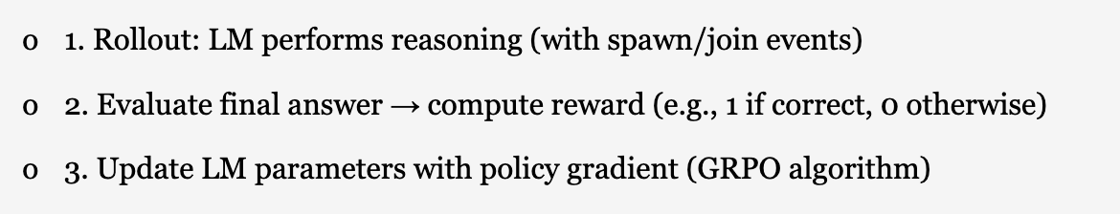
Key Innovation 2: End-to-End Reinforcement Learning
Traditional:
Hand-designed reasoning tree
APR: Use RL to teach the model…
When to call spawn()
How many children to spawn
What sub-prompts to give them
When/how to call join() and integrate results

Slide 38
Stream-of-Search (SoS/SoS+)
Serialized CoT technique using either BFS or DFS to solve reasoning problems
Authors use SoS+
Hybridizes BFS and DFS
Represents best serial CoT technique

Slide 39
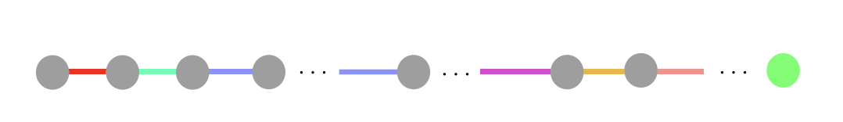
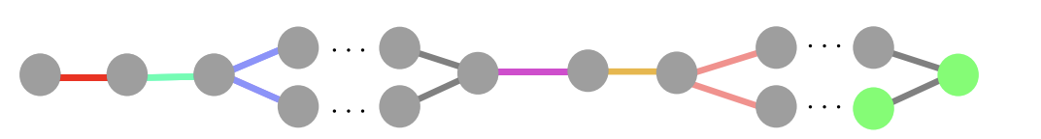
SoS+ vs APR, General
Previous chain-of-thought methods serialize the reasoning tree even if they have parallelizable components.
APR trains the model to spawn child threads that work on sub-tasks in parallel.
Once completed, they are joined into the main thread.

Slide 40
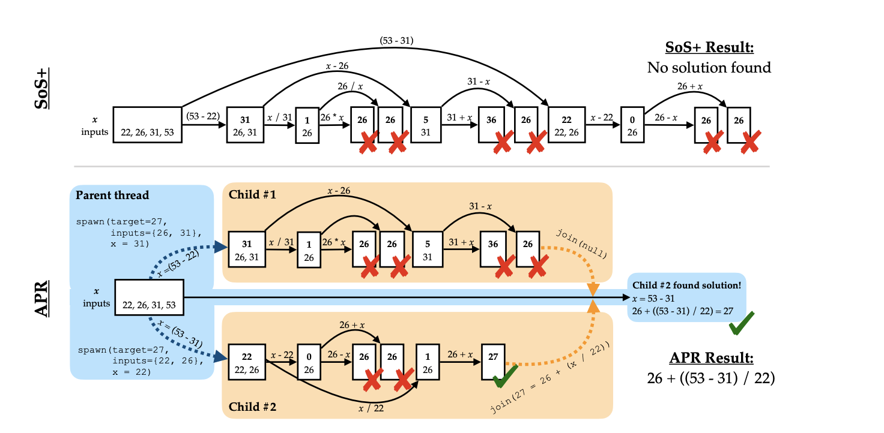
SoS+ vs APR, Countdown Task

Slide 41
Training Setup
Step 1: SFT
Teach models how to use spawn/join syntax
Sample solution traces generated by symbolic solvers
Step 2: Reinforcement Learning (GRPO)
Reward = correctness of solution (Countdown task)
Model learns how to allocate compute (child threads)

Slide 42
Experiments: Countdown Task
Goal: Find arithmetic expression using given numbers to reach target
Baselines:
SoS+
Serialized CoT hybridizing BFS and DFS
Represents best serial CoT technique
SoS + cons@n:
Parallel independent SoS runs
Used to scale up SoS+ compute
Metrics: Accuracy, total token usage, latency
Latency measured using both sequential tokens and wall-clock time

Slide 43
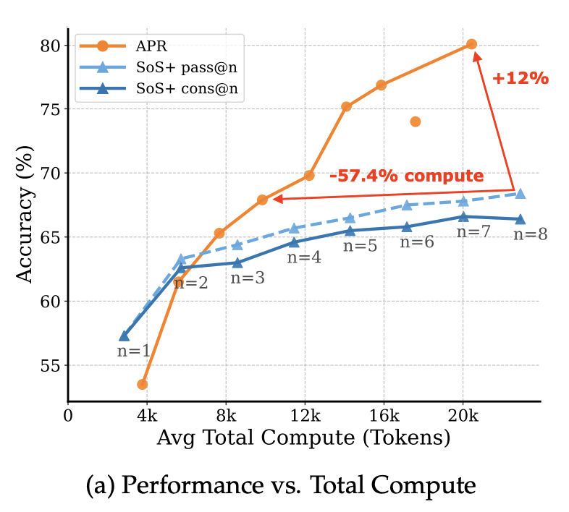
Experiments: Results
Baseline: SoS with cons@n
Total compute scaling:
SoS: Increase N in Best-of-N sampling
APR: Increase number of child threads
“Parallelism overhead”: Worse in low-compute regimes (<4k tokens)
Superior scaling by enabling parallel execution of child threads

Slide 44
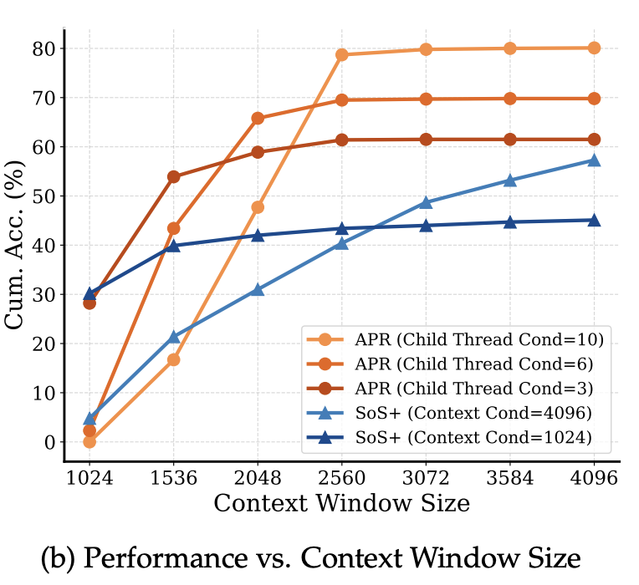
Experiments: Results
Baseline: SoS+
APR superior at exploiting context
Parallel reasoning:
More total tokens
Not packed into one context window

Slide 45
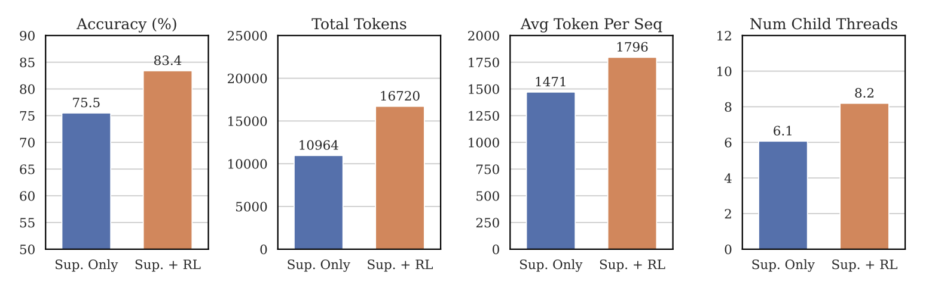
Experiments: APR Pre- vs Post- RL
Breadth (num threads) scaled up more than depth (tokens/seq)

Slide 46
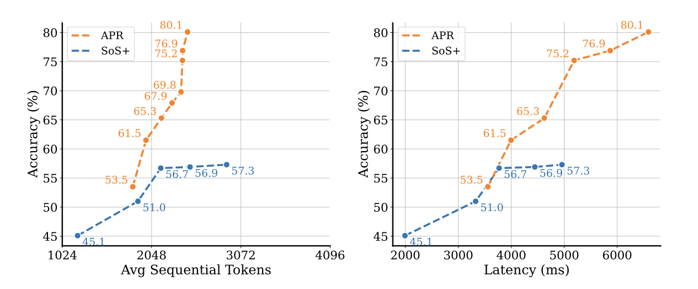
Experiments: Efficiency
APR achieves higher accuracy with fewer tokens and lower latency
Superior efficiency

Slide 47
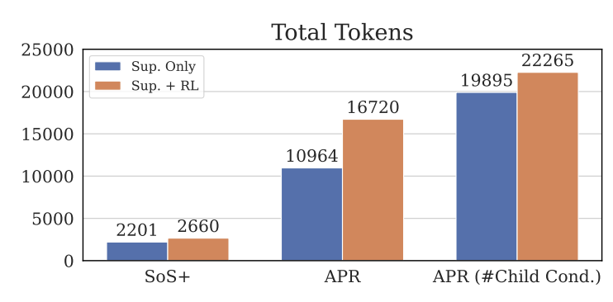
Ablation: RL in APR and SoS+
RL improves performance and increases token usage
APR saw a greater increase in token usage
Parallelization allows scaling beyond context limitations
APR (# Child Cond.): Model always uses max number of child threads (10)

Slide 48
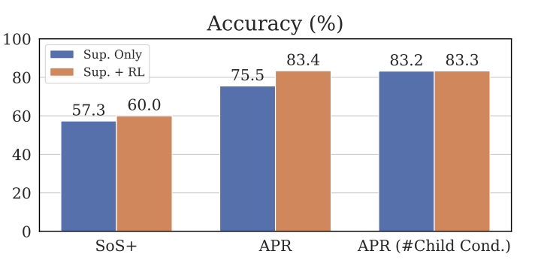
Ablation: RL in APR and SoS+
APR saw a greater increase in accuracy than SoS
Far less when fix number of child threads at 10:
RL teaches model to scale compute, rather than improving decision quality
APR (# Child Cond.): Model always uses max number of child threads (10)

Slide 49
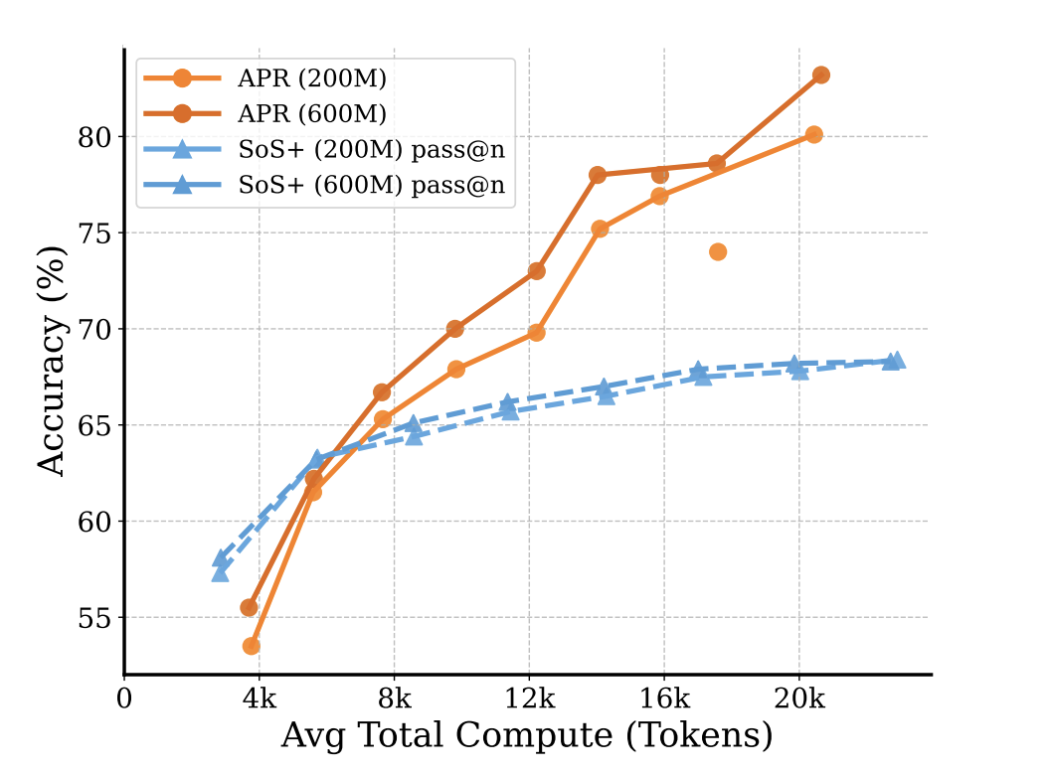
Results with Larger Models
Previous results use a 293M-parameter model following Llama2
Findings scale to 600M-parameter models
APR scales better with model size than SoS+

Slide 50
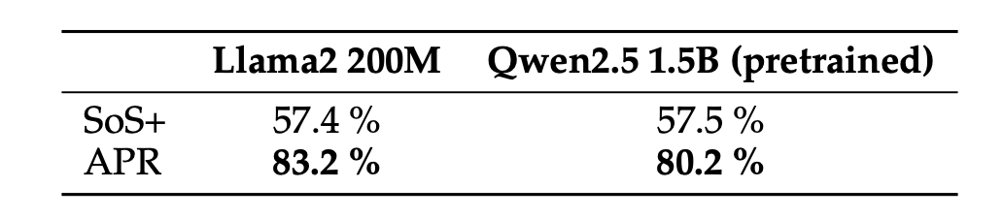
Results with pretrained models
Models used in main study were trained from scratch
Goal: Verify findings scale to large pretrained models

Slide 51
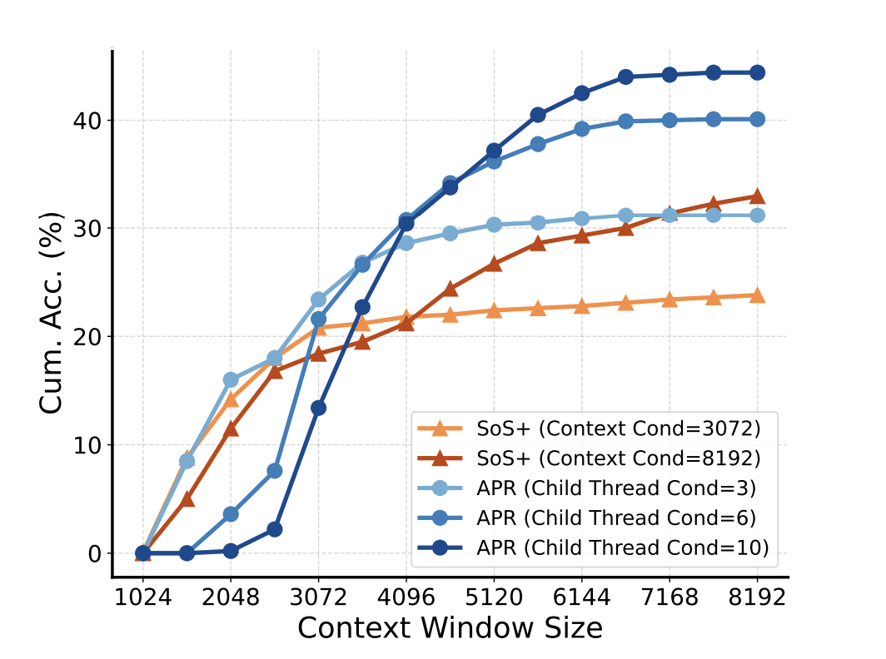
Results on Larger Countdown Task
Countdown with 4 numbers previously; now 5
Search space 40x larger
Context budget expanded to 8k tokens

Slide 52
Summary
Motivation: Scaling LLM inference via intelligent parallelism
Serial CoT: Context window limitations; latency
Existing parallel methods: Poor coordination; redundancy
Hand-designed reasoning trees: Lack flexibility
Key contribution: Intelligent, model-powered parallelism
Language models provided parent-child threading mechanism
End-to-end training via Reinforcement Learning

Slide 53
Discussion Questions
Do we expect this improvement to generalize to other tasks?
What kinds of tasks benefit from parallelization?
Brute force in disguise?
Main benefits are from scaling threads for greater token usage

